Slide 1

Introduction to Practical Machine Learning
23 October 2026
PRACTICAL MACHINE LEARNING · DAY 01 OF 18
From a problem statement to a working, evaluated model
4 hours theory · 3 hours practical · Python and scikit-learn
Notes:
Welcome the batch. Today is the foundation for the next 17 sessions: by the end of the day every student will have trained and evaluated their own model. Set expectations: intuition first, code second, maths later in the course.

Slide 2
Seven hours, one complete workflow
TODAY
Block | Time | What we cover
Theory 1 | 60 min | What ML is, how it works, core terminology
Theory 2 | 60 min | Supervised, unsupervised and other approaches
Theory 3 | 60 min | The ML lifecycle, applications, a fraud case study
Theory 4 | 60 min | Train/test splits, overfitting, evaluation metrics
Lab 1 | 60 min | Python environment and Iris data exploration
Lab 2 | 60 min | Train your first classifier (KNN)
Lab 3 | 60 min | Evaluate the model and experiment
Day 01 · Introduction to Practical Machine Learning · 2
Notes:
Ten-minute breaks after Theory 2 and Lab 1; lunch between theory and lab. Every theory hour ends with a short exercise from the exercise sheet.

Slide 3
By the end of today, you can
LEARNING OUTCOMES
Define machine learning and contrast it with rule-based programming
Identify features, target, observations and labels in any problem
Classify a problem as classification, regression or clustering
List the seven stages of the ML lifecycle and the purpose of each
Explain why models are tested on unseen data, and spot overfitting
Say what accuracy, precision, recall, F1, MAE, MSE and RMSE measure
Load, explore, split, train, predict and evaluate a model in scikit-learn
Day 01 · Introduction to Practical Machine Learning · 3
Notes:
Read these out quickly. Return to this slide at the end of the day and ask students to rate themselves 1 to 5 on each outcome.

Slide 4
Introduction to Machine Learning
THEORY · HOUR 1 · 60 MIN
What ML is · How it works · Core terminology · Features and targets
Notes:
Core idea for the hour: a model learns a mapping from inputs to outputs by studying examples, instead of being told the rules.

Slide 5
AI, machine learning and deep learning
TOPIC 1 · WHAT IS ML?
Artificial intelligence
AI — machines doing tasks that need human-like intelligence: reasoning, perception, language, decisions.
Machine learning
Machine learning — systems that improve at a task by learning from data, not hand-written rules.
Deep learning
Deep learning — ML with multi-layer neural networks; strongest on images, audio and text.
Multi-layer neural networks
Every DL system is ML. Not every ML system is DL.
Day 01 · Introduction to Practical Machine Learning · 5
Notes:
Draw the three nested circles on the board as you speak. Ask: is a chess engine from 1997 using hand-written search rules AI? Yes. Is it ML? No. This is the subset relationship.

Slide 6
A program learns when experience improves its performance
TOPIC 1 · DEFINITION
Tom Mitchell (1997): a program learns from experience E with respect to task T and performance measure P, if its performance on T, measured by P, improves with E.
Task T
Experience E
Performance P
Label each incoming email as spam or not spam
50,000 past emails already labelled by users
Percentage of emails labelled correctly
Day 01 · Introduction to Practical Machine Learning · 6
Notes:
Ask students to fill T, E and P for a second example: a phone keyboard that predicts your next word. T: predict the next word. E: everything you have typed. P: how often you accept the suggestion.

Slide 7
Traditional programming vs machine learning
TOPIC 1 · TWO WAYS TO BUILD SOFTWARE
Traditional programming
Machine learning
Data + rules
→
Program
→
Answers
Data + answers
→
Algorithm
→
Rules (model)
Who finds the logic? The programmer.
Who finds the logic? The algorithm.
When the world changes: rewrite the code.
When the world changes: retrain on new data.
Day 01 · Introduction to Practical Machine Learning · 7
Notes:
The key flip: in ML the answers are an input and the rules are the output. The trained model is the rules the algorithm found.

Slide 8
Use ML when rules alone fall short
TOPIC 1 · WHY ML IS NEEDED
Rules too subtle to write
Rules keep changing
Recognising a handwritten “7” in a thousand handwriting styles
Spammers change their wording every week
Pattern hidden in data
Answers must be personal
Which customers will cancel their subscription next month
Netflix recommendations for 200 million different viewers
Day 01 · Introduction to Practical Machine Learning · 8
Notes:
If none of the four applies, a simple rule is usually cheaper and easier to explain. ML is a tool, not a default.

Slide 9
A rule-based spam filter breaks quickly
TOPIC 1 · EXAMPLE
def is_spam(email):
“You are a WINNER! Click here”
words = ["free", "winner", "lottery"]
text = email.lower()
Rule says spam · correct
return any(w in text for w in words)
“Free lunch in the cafeteria today”
Rule says spam · wrong, it is genuine
“Fr33 l0ttery pr1ze waiting”
Rule says not spam · wrong, rule dodged
Day 01 · Introduction to Practical Machine Learning · 9
Notes:
Ask: how many rules would you need to fix both mistakes, and how often would you update them? An ML filter instead learns word weights from thousands of labelled emails and is simply retrained when spam changes.

Slide 10
Rules or ML? Decide, and give one reason
Exercise 1.1 · 3 min · pairs
1
2
3
Calculate GST on an invoice
Recognise a face to unlock a phone
Convert Celsius to Fahrenheit
4
5
6
Predict tomorrow’s milk demand at a supermarket
Check a password has at least 8 characters
Detect a fraudulent card transaction
Day 01 · Introduction to Practical Machine Learning · 10
Notes:
Answers: 1 rules, 2 ML, 3 rules, 4 ML, 5 rules, 6 ML. Push pairs for the reason, not just the label.

Slide 11
Learn from past examples, predict on new ones
TOPIC 2 · HOW ML WORKS
Past data
Training
New data
Prediction
→
Algorithm adjusts to match the targets
→
Model
→
→
Features X and known target y
The learned pattern
Features only, target unknown
The model’s output for it
Training data
Testing data
The goal
The part of the data the model learns from
Held back; used only to check the model
Perform well on unseen data, not memorise
Day 01 · Introduction to Practical Machine Learning · 11
Notes:
Analogy: a student practises with solved past papers (training data), then sits a new paper (test data). Memorising the answers fails the new paper; learning the method passes it.

Slide 12
Predicting a flat’s price from four features
TOPIC 2 · EXAMPLE
Area (sq ft) | Location | Bedrooms | Age (years) | Price (₹ lakh) · target
650 | Thane | 1 | 12 | 78
900 | Andheri | 2 | 8 | 185
1,200 | Powai | 3 | 5 | 260
750 | Thane | 2 | 3 | 95
1,050 | Andheri | 2 | 15 | 190
1,000 | Powai | 2 | 2 | ? · predict this
The first four columns are features; price is the target. The model learns from the five complete rows, then predicts the sixth. When that flat sells, comparing prediction with reality is evaluation.
Day 01 · Introduction to Practical Machine Learning · 12
Notes:
Ask what the model has probably learned: price rises with area and with location quality, and falls with age. Prices here are illustrative.

Slide 13
The vocabulary for the next 18 days
TOPIC 3 · TERMINOLOGY
Term | Meaning | Iris example (today’s lab)
Dataset | Full collection of examples | 150 flower records
Observation | One example (row, sample) | One flower
Feature (X) | A measurable input property | Petal length in cm
Label / target (y) | The value to predict | Species
Algorithm | The learning procedure | K-Nearest Neighbours
Model | What learning produces | A fitted KNN classifier
Parameter | Learned from the data | Slope m in y = m·x + c
Hyperparameter | Chosen before training | n_neighbors = 5
Training | Fitting the model to data | model.fit(X_train, y_train)
Inference | Using the model on new data | model.predict(X_new)
Day 01 · Introduction to Practical Machine Learning · 13
Notes:
Students will hear observation, sample, row and instance used for the same thing; and label, target, output and y likewise. Tell them so.

Slide 14
Algorithm vs model, parameter vs hyperparameter
TOPIC 3 · TWO DISTINCTIONS
Algorithm vs model
Parameter vs hyperparameter
The algorithm is the recipe: the same for everyone.
In y = m·x + c, the slope m and intercept c are parameters: the model learns them.
The model is the cake: it depends on the ingredients, the data you used.
How many neighbours KNN looks at is a hyperparameter: you choose it before training.
Same KNN algorithm + Iris data = an Iris model. Same algorithm + wine data = a different model.
Choosing hyperparameters well comes later in the course.
Day 01 · Introduction to Practical Machine Learning · 14
Notes:
Check understanding: ask whether the learning rate, the number of trees in a forest, and a regression coefficient are parameters or hyperparameters.

Slide 15
Spot the pieces, then match the terms
Exercises 1.2 and 1.3 · 8 min · individual
1.2 · Heart disease records
1.3 · Name the term
2,000 patients: age, blood pressure, cholesterol, smoker (yes/no), BMI, and heart disease within 5 years (yes/no).
“The weight for area came out at 0.12”
“We set maximum tree depth to 4”
“Row 37: a 900 sq ft flat in Andheri”
“Whether the email is spam”
“Number of bedrooms”
“All 10,000 loan applications from 2025”
Which columns are features?
What is the target?
How many observations?
1,600 train: how many test?
What does the model output?
Day 01 · Introduction to Practical Machine Learning · 15
Notes:
1.3 answers: parameter, hyperparameter, observation, label, feature, dataset. 1.2 answers: five features listed; target is heart disease within 5 years; 2,000; 400; yes/no or a probability.

Slide 16
Find the features and the target
Discussion · 10 min · three groups
A · House price
B · Email spam
C · Customer segments
Which features would you collect? What is the target? A number or a category?
What features can you extract from an email? Where do the labels come from?
What describes a customer? Is there a target column? If not, what does the model produce?
Each group reports back in 2 minutes.
Day 01 · Introduction to Practical Machine Learning · 16
Notes:
Use group C to set up Hour 2: it has no target, which leads straight into unsupervised learning.

Slide 17
Types of Machine Learning
THEORY · HOUR 2 · 60 MIN
Supervised · Unsupervised · Semi-supervised and reinforcement · Classification vs regression vs clustering
Notes:
One question sorts most problems: do we have the correct answer for each training example? Yes: supervised. No: unsupervised.

Slide 18
Supervised learning learns from labelled examples
TOPIC 5 · SUPERVISED LEARNING
Classification
Regression
Predicts a category. Binary: two classes. Multiclass: three or more.
Predicts a number on a continuous scale.
House price
Air Quality Index
Next month’s sales
Spam or not spam
Disease category
Customer will leave or stay
Quick test: can the prediction be “off by 3.5”? Then it is regression. Trap: a 1–5 star rating or a postcode is written as a number but behaves as a category.
Day 01 · Introduction to Practical Machine Learning · 18
Notes:
Show how framing changes type: tomorrow’s temperature is regression; ‘will it be above 30 °C, yes or no’ is classification.

Slide 19
Six supervised algorithms you will meet
TOPIC 5 · ALGORITHMS
Algorithm | Used for | One-line intuition
Linear Regression | Regression | Fit the best straight line through the points
Logistic Regression | Classification | Estimate the probability of a class
Decision Tree | Both | A flowchart of yes/no questions
Random Forest | Both | Many trees vote
Support Vector Machine | Mainly classification | Find the widest gap between classes
K-Nearest Neighbours | Both | Look at the K most similar known examples
Names only today. Each gets its own session; in today’s lab KNN is a black box.
Day 01 · Introduction to Practical Machine Learning · 19
Notes:
Point out that Logistic Regression is a classifier despite its name. Do not explain any internals today.

Slide 20
Unsupervised learning finds structure without labels
TOPIC 6 · UNSUPERVISED LEARNING
Clustering
Dimensionality reduction
Group similar rows: customer segments
100 survey questions compressed to 3 underlying factors
Association
Anomaly detection
Items bought together: bread and butter
Rows that fit no group: unusual network traffic
Algorithms you will meet: K-Means, hierarchical clustering, DBSCAN and PCA.
Day 01 · Introduction to Practical Machine Learning · 20
Notes:
K-Means splits data into K groups around centre points; hierarchical builds a tree of nested groups; DBSCAN groups dense regions and marks isolated points as noise; PCA finds new axes that keep the most variation.

Slide 21
A clothing store’s customers, grouped by behaviour
TOPIC 6 · EXAMPLE
Cluster | Visits / month | Average bill (₹) | Bought on discount | Name the business gives it
1 | 4 | 1,200 | 70% | Bargain hunters
2 | 1 | 6,500 | 10% | Premium occasional
3 | 3 | 3,000 | 30% | Loyal regulars
The algorithm finds the groups; people name them and judge whether they are useful. There is no single right answer to check against, which makes unsupervised models harder to evaluate.
Day 01 · Introduction to Practical Machine Learning · 21
Notes:
Figures are illustrative. Ask what marketing would do differently for each group.

Slide 22
Two more learning approaches
TOPIC 7 · AWARENESS ONLY
Semi-supervised learning
Reinforcement learning
A small labelled set plus a large unlabelled set; the model uses both.
An agent takes actions, gets rewards or penalties, and learns a strategy by trial and error.
Example: 500 labelled medical scans and 50,000 unlabelled ones.
Example: a game-playing AI, a robot learning to walk, warehouse routing.
Day 01 · Introduction to Practical Machine Learning · 22
Notes:
Five minutes only. Mention in one sentence that large language models are pre-trained with a related idea, self-supervised learning.

Slide 23
Classification, regression or clustering?
Exercise 2.3 · 10 min · pairs
1
2
3
Telecom: will a subscriber switch to a competitor next month?
City: tomorrow’s Air Quality Index for Mumbai
Retailer: group 2 lakh products with no existing categories
4
5
6
Bank: the credit limit to offer a new customer
School: which digit (0–9) is handwritten in a box
Music app: groups of listeners with similar taste
Day 01 · Introduction to Practical Machine Learning · 23
Notes:
Answers: 1 classification, 2 regression, 3 clustering, 4 regression, 5 classification (multiclass), 6 clustering. Debrief by asking two pairs who disagreed to explain. Exercises 2.1 and 2.2 are on the sheet for early finishers.

Slide 24
ML Workflow and Applications
THEORY · HOUR 3 · 60 MIN
The seven-stage lifecycle · Generalisation · Applications by industry · Bank fraud case study
Notes:
Training the model is one of seven steps, and usually not the longest.

Slide 25
Seven stages from problem to production
TOPIC 9 · LIFECYCLE
1
2
3
4
5
6
7
Define the problem
Collect data
Explore and prepare
Split the data
Select and train
Evaluate
Deploy and monitor
Records with features and target
Score on unseen test data
Decision, target, success measure
Clean, fix and convert
Hold back a test set
Pick an algorithm, fit it
Use it, watch it, retrain
It is a loop, not a line. A weak evaluation sends you back to step 3 or even step 1, and monitoring tells you when to retrain. Garbage in, garbage out: a better algorithm rarely fixes bad data.
Day 01 · Introduction to Practical Machine Learning · 25
Notes:
Cover each stage’s purpose; detailed preprocessing is Day 2. Mention a baseline: a very simple model, or ‘always predict the average’, tells you whether ML adds value at all.

Slide 26
Predicting food-delivery time, stage by stage
TOPIC 9 · WORKED EXAMPLE
Stage | Food-delivery ETA (regression)
1 · Define | Predict minutes from order to doorstep; success = average error under 5 min
2 · Collect | 6 months of orders: distance, prep time, hour, weather, rider load, actual time
3 · Prepare | Drop impossible times (0 or 900 min); turn “rain” into a number
4 · Split | 80% of orders to train, 20% to test
5 · Train | Linear Regression as a baseline, then a Random Forest
6 · Evaluate | Test MAE = 6.2 min: not good enough, back to step 3 to add traffic
7 · Monitor | Weekly report of real vs predicted times; retrain monthly
Day 01 · Introduction to Practical Machine Learning · 26
Notes:
Figures are illustrative. Hand out Exercise 3.1 (put the loan-approval steps in order) from the sheet after this slide: answer b, d, f, g, e, a, c.

Slide 27
A model is only useful on data it has not seen
TOPIC 9 · GENERALISATION
Model A
Model B
99.8%
71%
94%
92%
Training accuracy
Accuracy on new emails
Training accuracy
Accuracy on new emails
Memorised the training emails; does not generalise.
Learned real patterns; generalises well.
Which one would you deploy?
Day 01 · Introduction to Practical Machine Learning · 27
Notes:
Let the class answer before revealing: Model B. This sets up Hour 4 on evaluation. Figures are illustrative.

Slide 28
Where ML is used today
TOPIC 10 · APPLICATIONS
Industry | Application | ML type | Inputs → output
Banking | Fraud detection | Classification | Amount, place, device → fraud yes/no
Banking | Credit risk | Classification | Income, loans, history → default yes/no
Healthcare | Disease prediction | Classification | Blood tests, age → diabetic yes/no
E-commerce | Recommendations | Both | Purchase history → ranked products
Manufacturing | Predictive maintenance | Classification | Vibration, heat → failure in 7 days
Transport | Demand prediction | Regression | Time, weather, events → cab requests
Marketing | Segmentation | Clustering | Spend, frequency → customer groups
Cybersecurity | Intrusion detection | Anomaly detection | Traffic patterns → normal or suspicious
Day 01 · Introduction to Practical Machine Learning · 28
Notes:
Make it local: UPI fraud alerts, Swiggy and Zomato ETAs, Flipkart’s ‘customers also bought’, crop-yield prediction. Then run Exercise 3.2: each student writes one application from their own project or internship.

Slide 29
Bank fraud detection
CASE STUDY · 10 MIN · GROUPS OF 4
Answer as a group
What is the problem, in one sentence?
List at least six features
What does the model output?
Which type of ML is this?
How would you split 2 years of data for testing?
A model says “genuine” every time: what is its accuracy, and is it useful?
Which mistake is worse: blocking a genuine payment, or allowing a fraud?
0.1%
of 10 lakh card transactions a day are fraud. The bank has 2 years of history, each marked fraud or genuine.
Notes:
Questions 6 and 7 lead into Hour 4: always-genuine scores 99.9% accuracy and catches no fraud; different errors have different costs. Split by time: train on the earlier months, test on the latest.

Slide 30
Evaluating Machine Learning Models
THEORY · HOUR 4 · 60 MIN
Train, validation and test sets · Overfitting and underfitting · Classification and regression metrics · Recap quiz
Notes:
A model is judged only by how it performs on data it has never seen.

Slide 31
Three sets, three different jobs
TOPIC 12 · SPLITTING DATA
Training · 70%
Validation 15%
Test 15%
Training
Validation
Test
Fits the model. Like the textbook and practice problems.
Compares models and tunes settings. Like mock tests.
Touched once, for the final honest score. Like the board exam.
Today’s lab uses train and test only. Watch out: shuffle sorted data, and for time-based data train on the past and test on the future.
Day 01 · Introduction to Practical Machine Learning · 31
Notes:
Holdout evaluation is the simplest method: hold out a fixed share, commonly 20–30%, as the test set. Cross-validation, a better use of limited data, comes later in the course. If you keep tuning against the test set it stops being unseen.

Slide 32
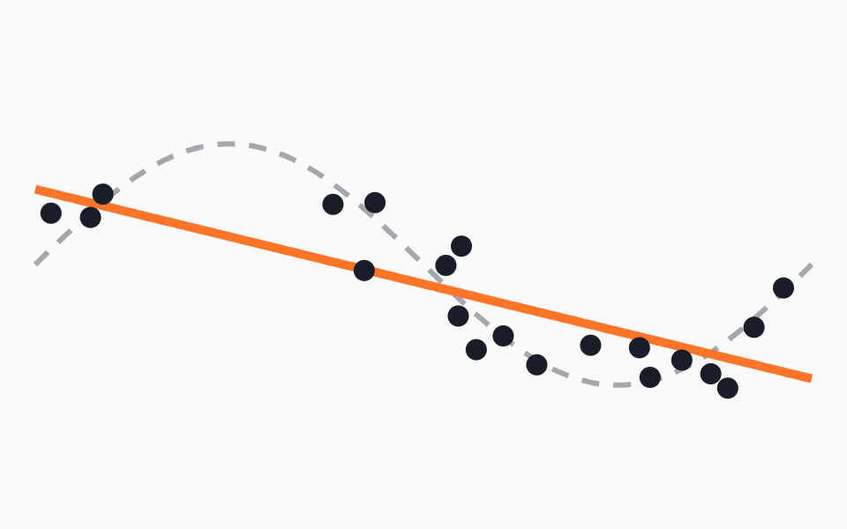
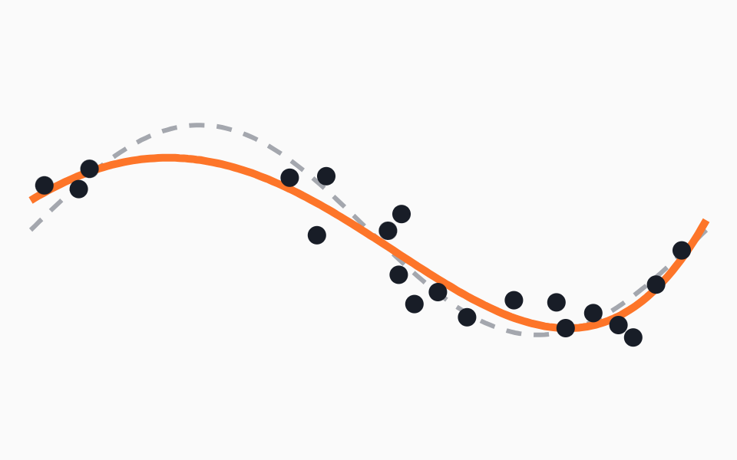
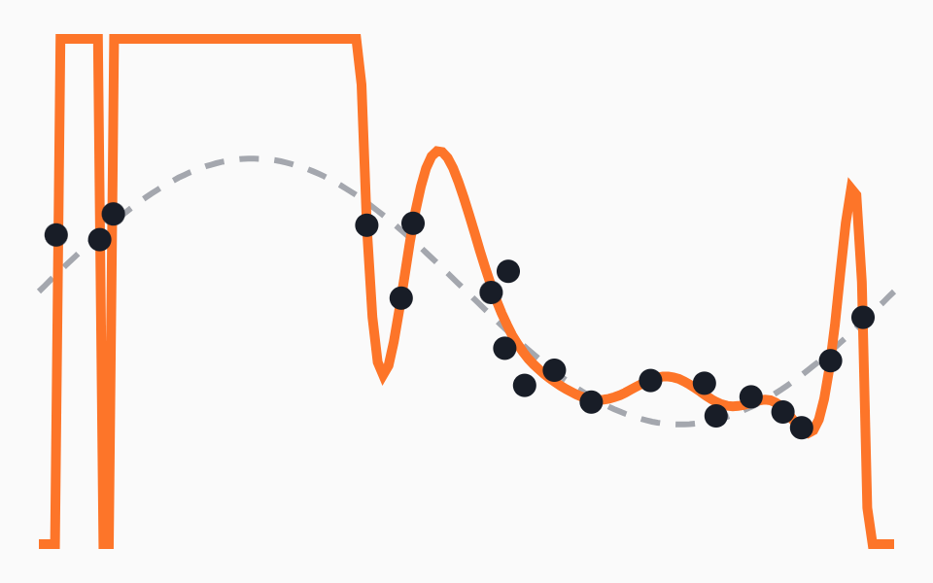
Underfitting, good fit and overfitting
TOPIC 13 · FIT
Underfitting
Good fit
Overfitting
Too simple: a straight line misses the curve
Follows the real pattern, ignores the noise
Chases every point, swings wildly between them
Train low · test low
Train high · test high
Train very high · test lower
Dots: training data · orange line: the model · dashed grey line: the true pattern. Polynomials of degree 1, 4 and 15.
Day 01 · Introduction to Practical Machine Learning · 32
Notes:
Student analogies: underfitting is the student who skimmed the chapter; overfitting is the one who memorised answers; good fit understood the method. Bias, intuitively: error from overly simple assumptions (underfitting). Variance: too sensitive to the particular training data (overfitting). The trainer notebook code in the guide regenerates this figure.

Slide 33
Read the fit from training and test scores
TOPIC 13 · DIAGNOSIS
Situation | Train score | Test score | Gap | First things to try
Underfitting | Low | Low | Small | More informative features, a more flexible model
Good fit | High | High | Small | Deploy and keep monitoring
Overfitting | Very high | Lower | Large | More data, a simpler model, regularisation
Exercise 4.1 · 4 min
Diagnose each model from its train / test accuracy: 1 62% / 60% · 2 100% / 68% · 3 91% / 89% · 4 55% / 72%
Day 01 · Introduction to Practical Machine Learning · 33
Notes:
Answers: 1 underfitting, 2 overfitting, 3 good fit, 4 suspicious: a test score far above training points to a tiny or unrepresentative test set, luck, or a bug such as leakage.

Slide 34
Where a spam filter is right and wrong
TOPIC 14 · CONFUSION MATRIX
Predicted spam
Predicted not spam
TP 40
FN 10
100 test emails, 50 of them actually spam.
Actually spam
Correct: spam caught
Error: spam missed
Diagonal = correct predictions.
Off-diagonal = the two kinds of mistake, and they rarely cost the same.
FP 5
TN 45
Actually not spam
Error: genuine flagged
Correct: genuine passed
Day 01 · Introduction to Practical Machine Learning · 34
Notes:
Rows are actual, columns are predicted, the same layout scikit-learn uses in the lab. Ask: which mistake annoys a user more for a spam filter? A false positive, losing a real email.

Slide 35
Four numbers from the same confusion matrix
TOPIC 14 · CLASSIFICATION METRICS
Metric | Question it answers | Formula | Spam example
Accuracy | Of all predictions, how many were right? | (TP + TN) / total | 85 / 100 = 0.85
Precision | Of the emails flagged, how many were spam? | TP / (TP + FP) | 40 / 45 = 0.89
Recall | Of all real spam, how much did we catch? | TP / (TP + FN) | 40 / 50 = 0.80
F1-score | One number balancing precision and recall | 2PR / (P + R) | 0.84
Precision matters when false alarms are costly: a spam filter hiding a job offer.
Recall matters when misses are costly: cancer screening, fraud detection.
Accuracy misleads on imbalanced data: always “genuine” scores 99.9% and catches no fraud.
Day 01 · Introduction to Practical Machine Learning · 35
Notes:
Only establish what each metric measures today; detailed interpretation comes with the algorithms. Exercise 4.2 on the sheet: TP 30, FN 20, FP 10, TN 140 gives accuracy 0.85, precision 0.75, recall 0.60, F1 about 0.67.

Slide 36
How far off are the predicted prices?
TOPIC 14 · REGRESSION METRICS
Flat | Actual | Predicted | Error | |Error| | Error²
1 | 200 | 210 | +10 | 10 | 100
2 | 150 | 140 | −10 | 10 | 100
3 | 300 | 330 | +30 | 30 | 900
4 | 250 | 240 | −10 | 10 | 100
15
MAE · average absolute error, in lakh
300
Prices in ₹ lakh. RMSE is higher than MAE because squaring amplifies the one big miss, flat 3. For all three, lower is better.
MSE · average squared error, in lakh²
17.3
RMSE · square root of MSE, in lakh
Day 01 · Introduction to Practical Machine Learning · 36
Notes:
Exercise 4.3 on the sheet: actual 50, 60, 70; predicted 52, 57, 75. MAE 3.33, MSE 12.67, RMSE 3.56.

Slide 37
Eight questions on today’s theory
Recap quiz · 10 min · individual
1. Which is true? (a) all ML is deep learning (b) all deep learning is ML (c) ML and AI are the same (d) AI is a subset of ML
5. In Iris, sepal width is a ______ and species is the ______.
6. 99% on training, 70% on test is most likely: (a) underfitting (b) overfitting (c) a good fit
2. Traditional programming takes data and rules. ML takes data and ______.
7. Why do we keep a test set aside?
3. Predicting next month’s electricity bill in rupees is: (a) binary (b) multiclass (c) regression (d) clustering
8. For cancer screening, prioritise precision or recall? Why?
4. Grouping untagged news articles by topic is: (a) supervised (b) unsupervised (c) reinforcement (d) regression
Day 01 · Introduction to Practical Machine Learning · 37
Notes:
Answers: 1 b; 2 the correct answers (labels); 3 c; 4 b; 5 feature, target; 6 b; 7 honest estimate on unseen data and to detect overfitting; 8 recall, because a missed cancer is far costlier than a false alarm that further tests can clear.

Slide 38
Lab: build your first ML model in Python
PRACTICAL · 3 HOURS
# the pattern every scikit-learn model follows
Iris dataset
model = KNeighborsClassifier(n_neighbors=5)
150 flowers
model.fit(X_train, y_train) # learn
y_pred = model.predict(X_test) # predict
4 measurements in cm
accuracy_score(y_test, y_pred) # evaluate
3 species, 50 of each
Lab 1
Lab 2
Lab 3
Set up Colab, load Iris, explore and visualise
Split, train a KNN classifier, predict unseen flowers
Accuracy, confusion matrix, report, split experiments
Day 01 · Introduction to Practical Machine Learning · 38
Notes:
Students open the student notebook and fill in the TODO cells. Only the first line of the pattern changes for Decision Trees, Random Forests and SVMs later in the course. Expected result with random_state=42: 30 of 30 test flowers correct.

Slide 39
What to submit
BEFORE DAY 2
Iris notebook
Wine assignment
Marked out of 20
Runs top to bottom without errors
Exploration and two visualisations
Model, evaluation, split experiment
Lab tasks L1.1 to L3.4
A 5–8 sentence conclusion
load_wine(): 178 wines, 13 features, 3 classes
Same workflow, no step-by-step help
Diagnose the fit
Compare with Iris
Runs end to end · 3
Exploration · 3
Visualisation · 3
Correct workflow · 4
Evaluation · 4
Conclusion · 3
Conclusion question: how well does the model perform on unseen data, and what happens when the train-test split changes?
Day 01 · Introduction to Practical Machine Learning · 39
Notes:
Deadline: before the start of Day 2. Day 2 reuses the Wine notebook, so it must be complete.

Slide 40
Some wine features stay below 1; another runs past 1,000. KNN compares distances. What could go wrong?
A QUESTION TO SLEEP ON
Day 2 · Data preprocessing: missing values, encoding and scaling, on your Wine notebook
Notes:
Leave the question unanswered. Return to the outcomes slide and ask students to rate themselves on each.

